Slide 1
Inclusion Reach & Teach
TOOLKIT
Your guide to empowering women in construction
www.femalesinconstruction.eu
2023
Inclusion Reach & Teach Toolkit
Identification project
KA220-VET-8BD6FFB9

Slide 2
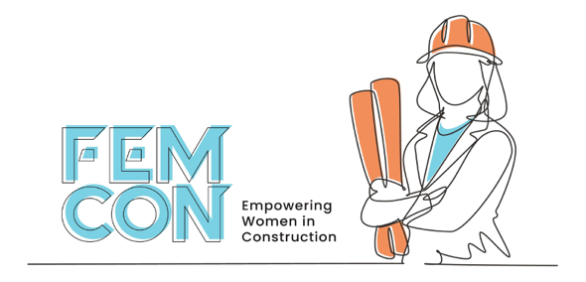
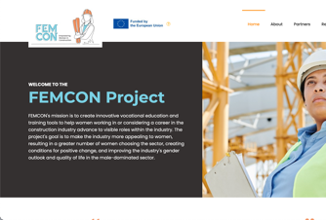
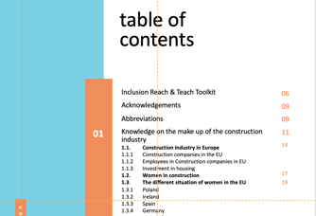
HOW TO USE THIS
The Femcon Inclusion reach & teach Toolkit is an online interactive set of resources and additional learning links. This content provides a deeper, self-guided learning opportunity featuring sustainable enterprise centres throughout Europe. We invite you to use these links and to explore and engage with the case studies and best practices in more detail.
INTERACTIVE
TOOLKIT
INTERACTIVE CONTENT IS IDENTIFIED IN THIS GUIDE BY THESE ICONS
CLICK
TO VIEW
DEEPER LEARNING
Click to find out more about our case studies
CLICK
TO VIEW
CLICK
TO VIEW
TOP TIP
To return to the compendium – use the click to go back option in your browser
FAST AND EASY NAVIGATION
Jump to a chapter of choice by clicking on the interactive table of contents at the beginning of the toolkit
CLICK
TO VIEW
CLICK
TO VIEW

Slide 3
PROJECT
Inclusion REACH & TEACH
Toolkit, Your guide to empowering women in construction
DOCUMENT VERSION
June 2023
PROJECT NUMBER
KA220-VET-8BD6FFB9
DISCLAIMER
Funded by the European Union. Views and opinions expressed are however those of the author(s) only and do not necessarily reflect those of the European Union or the European Education and Culture Executive Agency (EACEA). Neither the European Union nor EACEA can be held responsible for them.
Funded by the European Union. Views and opinions expressed are however those of the author(s) only and do not necessarily reflect those of the European Union or the European Education and Culture Executive Agency (EACEA). Neither the European Union nor EACEA can be held responsible for them.

Slide 4
table of
contents
Inclusion Reach & Teach Toolkit
06
Acknowledgements
09
Abbreviations
09
01
Knowledge on the make up of the construction industry
1.1. Construction Industry in Europe
1.1.1 Construction companies in the EU
1.1.2 Employees in Construction companies in EU
1.1.3 Investment in housing
1.2. Women in construction
1.3. The different situation of women in the EU
1.3.1 Poland
1.3.2 Ireland
1.3.3 Spain
1.3.4 Germany
1.3.5 Denmark
11
14
17
19
02
Knowledge about equality & inclusion challenges
for women in construction
2.1 Main Barriers & Challenges for Women in Construction
2.1.1 Lack of visible role models and mentors
2.1.2 Public perception
2.1.3 Awareness
2.1.4 Return to work
2.1.5 Lack of Diversity
2.1.6 Communication
2.1.7 Industry culture
2.1.8 Systemic and structural issues
2.1.9 Policies
2.2 Drivers of change
2.2.1 Education and training
2.2.2 Investment in and people and culture
2.2.3 Digitalisation and new technologies
2.2.4 Green transitions
2.2.5 Communications and branding
25
26
39

Slide 5
table of
contents
03
Knowledge on how to create an action plan
3.1 Gender Action Plan
3.1.1 How to create an Action Plan
3.1.2 How to design the strategy and actions?
3.1.3 Analysis and preparation
3.1.4 Implementation and monitoring
3.1.5 Evaluation
3.1.6 Good Action Plan examples
3.2 Best practice. Gender expert advice
3.2.1 Commitment to equality policies and regulation
3.2.2 Visibility and female referents in the sector
3.2.3 Training and career guidance
3.2.4 Generational change and innovation as tools for change
3.2.5 Action Plan FemCon
48
49
54
04
Inspiration towards the positive change in the construction industry
4.1 Good practices
4.1.1 Commitment and action
4.1.2 Transparency and communication work
4.1.3 Promoting women’s work and reducing the gender gap
4.2 Aspects that inspire. What's next for young women?
60
61
65
Bibliography
70
Appendices
73
A1: Research Information Sheet
73
A2: Research participant declaration
74

Slide 6
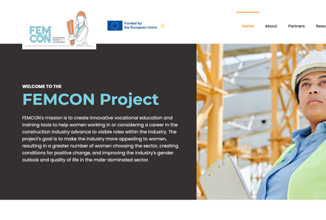
Inclusion Reach & Teach Toolkit
Introduction & Purpose
Equality is one of the core values to which the European Union is committed to implementing in all its policies and areas. It is the EU's own public institutions and its Member States that must take the initiative and incorporate the value of equality in their different areas. In the case of gender equality, it is especially necessary in the labour sector where we still find a very large gap in contrast to other political and social areas.
With this in mind, we have developed an inclusion reach & teach toolkit consisting of videos, text and graphics that will enable Vocational Education Trainers referred to hereinafter as (VET) educators to connect with women's work in construction and companies in the sector to motivate them to learn more about the need for change and to take action.
Who is the Toolkit for?
This Toolkit focuses on VET educators and companies in the European construction sector. It can also serve as a guide for organisations in the construction sector and actors who interact in one way or another in recruitment processes in the construction sector, as well as for people interested in starting equality work in their construction-related organisations.
Targeting a wide audience, the toolkit is focused on reaching out to VET educators and construction companies to design equality policies and strategies at all levels of work. In this way, it aims to inspire and improve the current situation and improve the quality of training to women in the construction sector through attractive guides and tools.
Inside the Toolkit
The toolkit is composed of four sections, section one focuses on providing information and knowledge about women in the construction sector, as well as data from European Union countries and prospects within the sector. Section two deals with the barriers and challenges women face in the sector, having gathered information through interviews, studies, and information from women in the construction sector. Section three provides key information on how to create a Gender Action Plan so that it can be implemented in each organisation, company or training institution, providing the necessary tools and knowledge to do so.
It also presents FEMCON's Action Plan, which focuses on providing educators and companies in the construction sector with tools to improve the situation for women, as well as the necessary knowledge to act from a gender perspective. Finally, section four offers inspirational material as well as a good practice guide. All audio visual or interactive material in this last section is included on the FEMCON website, providing an accessible way to access all the material.
CLICK
TO VIEW

Slide 7
Learning outcomes
This toolkit aims to provide learners with an enhanced knowledge of the Construction sector in Europe and the position of women therein. In doing so, learners will gain:
1
A better understanding of female participation in the European construction sector.
2
Insights into the barriers to entry into the sector.
3
Increased knowledge on new ways to attract women into the industry; and
4
The key steps involved in creating a Gender Action plan.

Slide 8
Construction is still a very masculinised sector where there is sometimes little support from companies and institutions for women who work in it
Considering the road travelled so far, we can highlight a series of lessons learned that serve as a basis for further progress and the development of this TOOLKIT to serve as an information and knowledge tool for VET educators, women, workers, and companies in general in the sector...
The sector needs modernisation as it is in a process of change, and therefore, needs to adapt to new market trends. These new trends are generating new jobs related to sustainability, digital skills which offer new opportunities for women who want to start a career in construction or for those who are already in the sector and want to upskill or reskill.
Moreover, the modernisation of the sector has highlighted the lack of training for both men and women.
The sector needs trained people, especially in new technologies and renewable energies. In order to be able to introduce well-trained men and women, progression pathways must be offered both at higher education levels (where the highest percentage of women in the sector is found) and in the trades (where the highest percentage of inequality between men and women in Construction exists), offering a complete package of training necessary to work in the construction sector. To date, in many cases, training is not complete and prevents women from gaining direct access to the sector after completing their training.
Finally, our learnings in recent years signals to much work to do to promote and encourage the participation of women working in the sector and their visibility within it, offering reference points to women working in the sector as well as to young women. There is still a lack of visibility in the sector when it comes to choosing a profession within the sector, due to a lack of training and lack of awareness from educators on where and how to guide women who want to work in the sector. Reconciliation policies have increased in recent years, allowing many women to consider working in construction. However, construction is still a very masculinised sector where there is sometimes little support from companies and institutions for women who work in it, both in terms of visibility and in terms of offering flexible policies to combine family and working life. The implementation of the Gender Action Plan in companies and organisations, is a step towards improving the status quo.
This toolkit a learning and teaching tool where we expose the current situation of women in the construction sector, it has improved, however it is trailing behind other industry sectors. It is through the combined knowledge and experience of women experts, workers in the construction sector and gender experts that we have co designed a Gender Action Plan. This will equip companies with a step-by-step guide on how to implement a similar model in their company or organisation. Finally, we offer some positive drivers for change and good practices which provide opportunities for companies to level the playing fields and be advocates for a diverse and inclusive construction sector.

Slide 9
Acknowledgements
This document was developed by FEMCON project partners.
POLAND: Federation of Associations of Scientifically technical notes council (NOT) (Project leaders, PR2 Project lead)
SPAIN: Fundación Laboral de la Construccion (FLC) (PR1 Project lead)
GERMANY: Outside Media & Knowledge (Outside) (PR3 Project lead)
IRELAND: Momentum Marketing Services Limited (MMS) (Quality & communication Project lead)
IRELAND: Future Cast (FC) (PR1 Co Project lead)
DENMARK: European E-Learning Institute funded by the European Union (EUIE). (PR4 Project lead)
This document has been developed with the support of male and female participants in the research interviews which we have used to obtain their point of view and experience within the construction sector. Qualitative interviews were conducted nineteen research participants from the Construction sector, a sample from
Spain - 4 Ireland - 6 Poland - 4
Germany - 3 Denmark - 2
A further twelve qualitative interviews were carried out with gender experts, two from each partner country which provides deep insights into a rich sample across Europe. Special thanks to our Gender experts who have shared their knowledge and expertise to inform our good practice guide.
This Research report was collated and drafted by Beatriz Oliete and Marta Pérez Ríos from Fundacion Laboral de la Construccion (FLC); and Mary Whitney and Niamh Kenny from Future Cast (FC).
Publications on www.femalesinconstruction.eu is credited to Kathy Kelly, Canice Hamill and Catherine Neill of the European E-learning Institute. Toolkit documents and literature were designed and directed by Lola Gonzalez from Momentum Marketing Services Limited (MMS).
Abbreviations
CIF Construction Industry Federation
EU European Union
EUIE European E-Learning Institute
FLC Fundación Laboral de la Construcción
FC Future Cast
GVA. Gross Value Added
Outside Outside Media & Knowledge UG (Haftungsbechrankt)
NOT Federation of Associations of Scientifically Technical Notes Council of the Zachodniopom orski region in Szczecin
ILO International Labour Organization
WCB Project “Women Can Build”
ETUI European Trade Union Institute for Research
OECD The Organization of Economic Cooperation and Development
HEA Higher Education Authority
TEAGASC Agriculture and Food Development Authority

Slide 10
Women in the industry can lay a solid foundation for those interested in pursuing a career in construction.

Slide 11
01
Knowledge on the make up of the construction industry

Slide 12
The EU construction industry's future is jeopardized by a chronic labour shortage - Europe's construction output cannot keep up with demand. Prior to COVID-19, there was a labour shortage in the construction industry. Now, the industry is facing even more labour challenges, just as growth appears to be on the horizon. Women make up only 9% of the construction industry's workforce in Europe, leaving a huge talent pool untapped. Construction labour shortages in the EU are also expected to worsen in the future as the population declines and the workforce ages. During pandemic, the number of women in construction fell even further, according to the research article.
The EU construction needs to employ more women if it is to have a sustainable future. That's why, as we present in our project.
"Despite research indicating that 83% of managers in the construction sector believe their industry is suffering from a skills shortage, little is being done to encourage a more diverse workforce and, as a result, widen the talent pool available.”¹
¹ Fostering the demand for a skilled labour force in the construction industry. European Commission (November 2022)
https://build-up.ec.europa.eu/en/resources-and-tools/articles/overview-article-fostering-demand-skilled-labour-force-construction. Accessed in May 2023

Slide 13
FEMCON's mission is to create innovative vocational education and training tools to help women working in or considering a career in the construction industry advance to visible roles within the industry. The project's goal is to make the industry more appealing to women, resulting in a greater number of women choosing the sector, creating conditions for positive change, and improving the industry's gender outlook and quality of life in the male-dominated sector.

Slide 14
1.1. Construction Industry in Europe
The construction sector has been influenced in 2022 by seismic global events; on the one hand the war in Ukraine has affected all Europe, together with the aftermath of the Global pandemic and the legacy of Covid-19 that affected every fabric of social and economic life. The lingering impact bears witness to price inflation that directly affects the construction sector through soaring material costs and rising energy prices.
The construction sector is currently in a period of stagnation in terms of growth but maintaining good levels of production after inflation and the COVID-19 crisis, closing 2022 with a growth of 3%, in line with forecasts from Eurconstruct², which estimated a growth of 3.6% for 2022. Even so, the current situation in Europe will have a direct effect on the construction sector, with the sector expected to stagnate by a further 0.2% and where forecasts for 2024 predict further stagnation for the sector.
Focusing on the sub-sectors within construction, new construction has the worst forecasts. Regarding residential building, the excess "stock" in some EU countries due to the lack of sales is causing the development of new projects to stop, forcing prices down. As a result, the sector is expected to contract during 2023 and 2024.³
On the other hand, regarding new production in "non-residential" works, it has still not recovered to pre-pandemic levels, being the sub-sector with the worst recovery forecast within the sector. This is a problem if we understand that this sub-sector is responsible for 17% of non-residential production (ibid).
If we look at the refurbishment sub-sector, it closed 2022 with 4.5%. This growth is partly due to some financing programmes such as the 110% "SuperBonus”⁴ in Italy focused on energy efficiency measures, demolition, and reconstruction of old buildings. And if we focus on the civil engineering subsector, it is the one that has had a growth of 0.6% but despite these discrete data, it is expected to be the subsector that benefits most from aid such as the NextGeneration EU funds, being able to relatively avoid the stagnation that we find in other construction subsectors.
Considering the latest data provided by the European Union through Eurostat⁵, the percentage of GDP contributed by the construction sector in the EU is 5.5%. Another way of measuring the size of the sector within the EU is through the Gross Value Added (GVA) which has been varying over the last 13 years, increasing again from the period 2014 - 2017 registering a fall of 5.1% and increasing again to 5.5% in 2020 and 2021.
Among the EU countries where the GVA has fallen the most between 2010 and 2021 were Spain, Bulgaria, Greece, and Slovakia, while the highest growth was recorded in Hungary, Lithuania, Denmark, Germany and Finland, the latter being the one that recorded the highest growth in 2021 with a growth of 7% (ibid).
² Euroconstruct - Summary of the Euroconstruct report. (November 2022): https://itec.es/servicios/estudios-mercado/euroconstruct-sumario-ultimo-informe/. Accessed in May 2023
³ European Construction Sector Observatory, 2021
⁴Costruzioni Italia S.P.A. (2022): “Superbonus 110%”. https://www.costruzioniitalia.it/servizi/superbonus-110/#:~:text=''Casa%20a%20zero%20o%20zero,2020%20al%2031%20dicembre%202021. Consulted in May 2023
⁵ Construction sector – European Commision (2020) “Gross value added of the construction sector in the EU”. https://ec.europa.eu/eurostat/cache/digpub/housing/bloc-3a.html?lang=en#:~:text=Gross%20value%20added%20of%20the,the%20period%202010%20to%202021. Consulted in May 2023

Slide 15
1.1.1 Construction companies in the EU
France has the highest number of companies and people employed in the construction sector. In 2020 Île de France recorded a total of 176,000 companies, in the Provence-Alpes-Côte d'Azur area a total of 89,000 companies and in Rhône-Alpes 85,000 construction companies were counted. In the Lombardy region of Italy, there are 95,000 construction companies.⁶
1.1.2 Employees
in Construction companies in EU
If we look at people employed in companies in the sector, Île de France leads the way with 605,000 people employed in construction companies, followed by Lombardy with 256,000 people with 2019 data, along with Catalonia and Madrid which had a total of 203,000 and 205,000 people employed, respectively (ibid).
1.1.3 Investment in housing
If we look at the data obtained after the Covid-19 pandemic, Eurostat indicates that in 2021 5.6% of GDP in the EU will be invested in the housing sector, although this is an irregular figure.
For example, the highest percentage of investment is found in countries such as Germany with 7.2% of its GDP or Cyprus with 7.6%, while the lowest figures are found in Greece with a total of 1.3% or Ireland with 2.1%. (ibid).
⁶ Eurostat, 2019 https://ec.europa.eu/eurostat

Slide 16
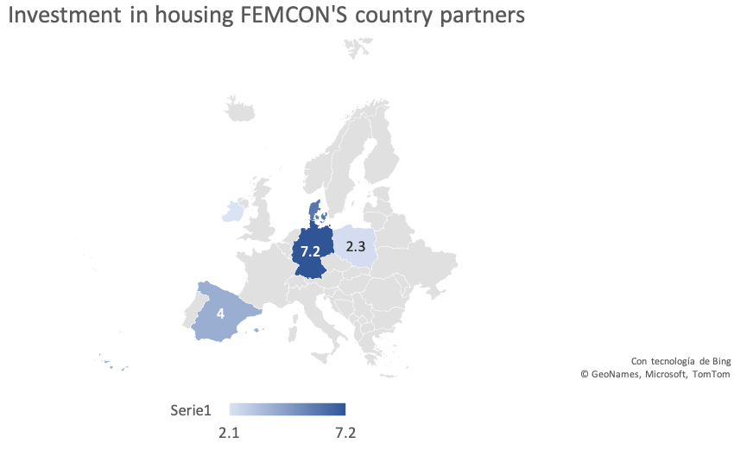
Below is the data of the countries participating in the FEMCON project.
Germany 7,2%
Denmark 6%
Spain 5,4%
Poland 2,3%
Ireland 2,1%
Figure 1: Investment in housing in Germany, Denmark, Spain, Poland, and Ireland. Adapted from Investment in housing (in % of GDP) (2021) Source: Eurostat

Slide 17
1.2 Women in construction
Women have historically worked in construction since the Middle Ages. We can find writings showing that some women worked in the construction of Toledo Cathedral in Spain during the 15th century or in the United Kingdom. Woodward, 1995 notes that
"At Durham in 1687 John Baker and his son worked for four and a half days and Margaret Baker his wife' for two days repairing the flags in church and cloisters and carrying away the dirt' - John received 12d a day, compared with the normal 10d for labourer, and his son and wife each got 6d a day.”⁷
After the industrial revolution and towards the end of the nineteenth century many women began to stand out in the construction sector, with appearances by women such as Ethel Charles who was the first woman to be in the Royal Institute of British Architects or Julia Morgan who was the first woman member of the École Nationale Supériere des Beaux-Arts School of Architecture in Paris in 1902. We should not forget that, during the Second World War, women played a very important role in occupying many construction jobs, due to the war and the lack of male labour (ibid).
⁷ Woodward, D. 1995 Men at Work: Labourers and Building Craftsmen in the Towns of Northern England 1450–1750, Cambridge: Cambridge University Press.

Slide 18
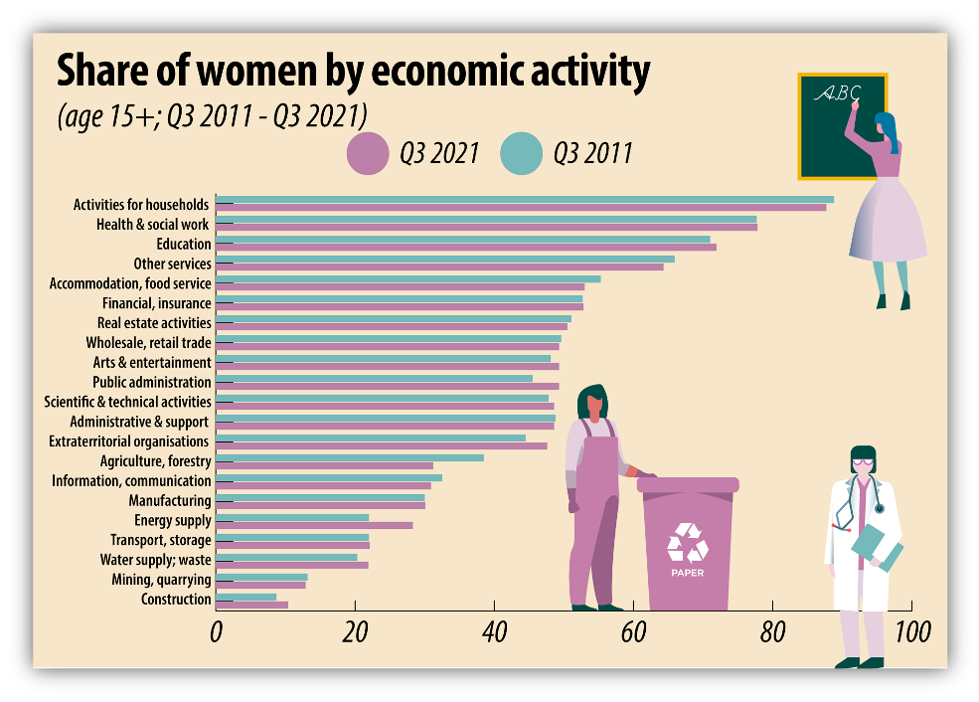
Currently European figures show that the construction sector is still the sector with the lowest representation of women, while domestic activities or the health and social sector have the highest representation of women with 88% and 78% respectively. ⁸
Figure 2: Share of women by economic activity. Employment by sex, age, and economic activity (from 2008 onwards, NACE Rev.2) – 100, (2023). Source: Eurostat.
Since then, we have come a long way, but construction is still a male-dominated sector where women represent 9% in Europe and where there is still a high proportion of women in the workforce.
⁸ Share of women by economic activity (from 2008 onwards, NACE Rev.2) – 100, (2023). Eurostat 2023

Slide 19
1.3 The different situation of women in the EU

Slide 20
1.3.1 Poland
According to the Polish labour market barometer- 2020, the booming construction industry is suffering from a shortage of skilled workers at a time when vocational training quality has been declining for decades. Although there are still significant differences in employment between men and women in the construction industry, it cannot be said that construction is solely a male occupation.
According to the Chamber of Civil Engineers, women make up 12% of construction engineers self-government (14,522 by the end of 2020). When it comes to active architects or skilled trades, the situation is different. In 2018, 10,356 women chose construction as their field of study, accounting for 34.1% of all students, up from 32.8% in 2017. While the trend of female students in construction increases, the VET sector needs to follow up & get ready. ⁹
The construction sector in Poland is mostly represented by men. According to official EU data from 2020, women accounted for 6.4% in the sector. In comparison with the rest of the EU countries, Poland is in second position with the highest proportion of women in managerial positions, with a total of 43%. This data can be attributable to the fact that women in Poland tend to be more highly educated than men, with 45% of women having higher education compared to 27% of men with the same level of higher education. ¹⁰
Following this data, in October 2021 the Polish financial newspaper Gazeta Finansowa, published a report called “Pearl of Polish Business” in which compared to past editions we can see more women in presidents’ positions in “masculinized” sectors like the construction. ¹¹
1.3.2 Ireland
The Construction Industry Federation research paper in 2018 “Women in the Construction Industry” conducted by Accuracy Marketing Research addresses the need to employ more women for a sustainable and competitive construction sector. ¹²
Construction Industry Federation (CIF) has found that on average approximately only 1 out of 10 construction workers are female. The survey found that on construction sites 99% of workers are male, whilst offsite, 54%, are male and 46% are female. Of those women working in constructions roles considerer “offsite” the majority work in administration, finance, HR, and marketing.
As the CIF’s research has highlighted, addressing the gender imbalance within Construction has a prominent role to play in addressing potential skills shortages in the coming years. It’s increasingly apparent that if we are to deliver the 35.000 needed to resolve the housing crisis and the 116€ billion entering the industry at all levels.
Construction business will need to enhance their managerial, financial, operations, marketing, technological and human resources to deliver modern construction. If women feel that this industry is not for them, we will never meet the ambition of Government strategies. Careers in construction have become more family-friendly, more technology driven, safer, less physically demanding and increasingly global in recent years. So, there are major opportunities in the industry.
⁹ Chamber of Civil Engineers, Poland (2021)
¹⁰ Eurostat, 2021
¹¹ Gazeta Finansowa, Pearl of Polish Business Report, October 2021
¹² Women in the Construction Industry. (2018) Accuracy Marketing & Construction Industry Federation, Ireland.

Slide 21
We have a lot of work to do, whilst 70% of companies recognize that the industry needs more women, a low percentage have structures in place to achieve this. The CIF survey showed 85% of respondents believed that female role models are important, in speaking to both young women in industry and to young girls considering their career options. Yet only 4% of companies were engaged in actively facilitating this.
To sum up, in Ireland the construction sector continues to be male dominated with the average percentage breakdown of men to women estimated at 89% and 11% respectively. In the other hand, men continue to occupy the more senior roles withing the industry and account for 99% of on-site positions (ibid).
In Ireland, the lack of gender balance is a recognised issue in the industry with 72% acknowledging a shortage of women in the sector and 65% agreeing that the industry is missing out by failing to attract female graduate. And the low number of women within the industry is viewed to be a product of gender stereotyping, a view that pervades all levels of society including primary and second level education. There is a broad agreement that there is a need for an improved gender balance within the sector (ibid).
1.3.3 Spain
Women in the Spanish construction sector have always had a low presence, not exceeding 10% representation.
Even so, according to the last report of the Spanish Construction Industry Observatory,¹³ the number of women affiliated to Social Security working in the construction sector was 147,337, which represented an increase of more than 7,000 women compared to the previous year. The highest percentage weight of women workers in the industry since 2016 was therefore reached, with 11.1% with respect to the total number of affiliated persons (ibid).
¹³ Spanish Construction Industry Observatory (2023): “Women in Construction” 2022” https://www.observatoriodelaconstruccion.com/informes/detalle/mujeres-en-el-sector-de-la-construccion-2022#:~:text=En%20la%20edici%C3%B3n%202022%20del,este%20y%20otros%20datos%20de Consulted in May 2023

Slide 22
Regarding the sector in general, a growth of 3.5% of workers has been detected compared to 2021, where in the case of women it rose by 5.5%. In addition, women in the sector work more frequently with permanent and full-time contracts in Spain, highlighting that 7 out of 10 workers are employed by others and the rest are self-employed. If we compare these data, the number of self-employed women in Spain working in the construction sector is almost twice as high as in other sectors, 26.7% compared to 13.8% (ibid).
It should also be noted that the activities most developed by women in the sector are activities related to specialised construction, where half of the Spanish women working in the sector are found, 51.2%, and building construction, where 44.7% of the women are found. Women in activities related to civil engineering account for 4.1% (ibid).
On the other hand, the percentage of women with higher education is the highest in the construction sector with 62.3% compared to 53% in the Spanish sector, and 9 out of 10 women working in the sector are of Spanish nationality. We can conclude by indicating that the construction sector continues to be a very male-dominated sector in Spain, which is nevertheless becoming aware of the situation and is taking inclusive and integrating measures (ibid).
The Spanish data, in comparison with other years, are positive, with the proportion of women having increased to 11.1%;¹⁴ however, many women are concentrated in administrative positions and in professions that require higher education. There is a difficulty in incorporating women into jobs on the construction site. Moreover, Spanish construction does not have any visible female referents. Due to the above, most women work in large or medium-sized companies, where there are more administrative jobs, since it is usually more difficult for women to join SMEs and micro small companies. On the other hand, there is an absence of women trainers, which hinders the work of inclusion and integration of women in the sector, intensifying the perception of being an entirely male sector (ibid).
1.3.4 Germany
Historically in Germany, women were also increasingly and systematically excluded from construction in the Western zones, in contrast to the East. In Germany women have only been allowed to work in construction for 26 years. It has a lot to do with history too. Until 1994, the 120-year-old employment band for women in the main construction trade was still in effect in the old federal states.¹⁵ The work on the construction sites is too heavy and too dirty. Only in the GDR was women allowed to operate cranes and other construction machinery. An East German reality that was countered by cloches and prejudices in the West after reunification. ¹⁶
While it was less than 10% in 2010, the number of women in the German construction industry has now grown to around 15%.¹⁷ In other western countries, too the proportion of women in construction is moving at a similar level. Although their number is increasing slowly, albeit steadily, in individual departments, the employment rate of female workers can differ greatly from one another. According to the Federal Statistical Office, 2023, women are most often to be found on the construction site in the fields of architecture, civil engineering, painting, or in surveying and cartography. Here they sometimes make up more than a quarter of the existing workforce. The tendency for construction professions with higher qualifications is still positive, as a look at universities and technical colleges shows. In architecture, more than half of the graduates across Germany are female. Around a third of the students in civil engineering are female. The situation is different in the skilled trades. In areas such as civil engineering, carpentry or flooring, the proportion of female employees fluctuates at a mere 1% - 3% (ibid).
¹⁴ Spanish Construction Observatory (2023): “Women in Construction 2022” https://www.observatoriodelaconstruccion.com/informes/detalle/mujeres-en-el-sector-de-la-construccion-2022#:~:text=En%20la%20edici%C3%B3n%202022%20del,este%20y%20otros%20datos%20de pag 12, Consulted in May 2023
¹⁵ https://www.sueddeutsche.de/geld/berufswahl-frau-am-bau-1.5033545
¹⁶ http://bauhandwerkerinnen.de/geschichte/geschichte.htm
¹⁷ (Federal Employment Agency, 2023)

Slide 23
1.3.5 Denmark
According to the latest available data from Statistics Denmark’s "Employment by industry, occupation, sex and region" report for 2020, women made up 17.3% of the workforce in the construction industry in Denmark. This corresponds to a total of 19,400 women out of a total workforce of 111,800. It's worth noting that this figure has been gradually increasing over the past decade, but there is still a significant gender imbalance in the industry.¹⁹
Like many countries, Denmark has historically been a male-dominated industry with a low number of women working in construction. However, over the past decade, there has been a growing awareness of the need to address gender inequality in the sector and to promote greater diversity and inclusion. The construction industry in Denmark faces several challenges when it comes to attracting and retaining women. These include a perception of the industry as male-dominated and not particularly welcoming to women, a lack of female role models, and concerns around safety on construction sites.
Additionally, the physical demands of many construction jobs may be seen as less attractive to women, although this perception is changing as new technologies and methods of working are introduced. To address these challenges, some initiatives have been introduced in Denmark to encourage more women to enter the construction industry. These include targeted recruitment campaigns, the provision of training and education programmes for women, and efforts to promote the industry as a viable career option for women. There are also ongoing efforts to improve working conditions and safety on construction sites to make them more welcoming to all workers, regardless of gender. Despite these efforts, there is still a long way to go in terms of achieving gender balance in the Danish construction industry. However, there is growing recognition of the benefits of a more diverse and inclusive workforce, and a commitment to continuing to promote greater gender equality in the sector (ibid).
¹⁹ Statistics Denmark, 2020. Employment by industry, occupation, sex, and region Report 2020

Slide 24
Women in the industry can lay a solid foundation for those interested in pursuing a career in construction.

Slide 25
02
Knowledge about equality & inclusion challenges for women in construction

Slide 26
To gain first-hand knowledge of the barriers and the situation of women working in the construction sector, we have conducted a series of interviews with both women experts with a relevant role in the sector, as well as women experts in policy and project development with a gender perspective.
From this series of interviews, we have extracted reflections that we have used for the development of this Toolkit as well as inspirational material that we hope will help to encourage young women who want to enter the sector, as well as to support women who are already in the sector and want to improve their position and visibility in it.
We also seek to bring the experience and perspective of these women closer through the publication of the interviews or extracts from them, which will allow us to offer a reflection for all those who view these materials.
Finally, this information has been analysed and included in the development of materials such as the Action Gender Plan linked to the objectives of the FEMCON project as well as the analysis of the current and real situation of women in construction.
2.1 Main Barriers & Challenges for Women in Construction
Construction has long been a male dominated sector synonymous with macho behaviour and masculinity, associated with strength and resilience, adaptability to the elements and outdoor work. This public perception coupled with a reluctance of school’s teachers and career guidance teachers to recommend it as a career choice negatively influence girls’ choices away from the construction industry.
There is a plethora of barriers for girls and women entering the industry ranging from social, economic, educational, and exclusionary industry practices. Retention issues are diverse and include lack of flexibility, stifled career paths, toxic culture, and overt sexism. Our interviews with female Construction professionals identify key barriers that are affecting young women’s entry point into the industry. Retention of women in the industry is another issue that points towards systemic barriers that covertly exclude women from progressing in their careers or provide flexibility to enjoy a good work life balance.
The main barriers will be explored further below primarily extrapolated from our primary research in the form of our qualitative interviews. This is supplemented with some secondary research and insights from key industry reports looking specifically at challenges facing women in the construction industry.

Slide 27
2.1.1 Lack of visible role models and mentors
This emerged as a recurring theme throughout the interview process.
"If you can’t see it, you can’t be it”
“There is a notable difference in the level of seniority of women working in the sector with companies estimating that only 10% of senior management and 3% of CEO’s are women”. ²⁰
Due to the lack of visibility of women working in the sector, there is a lack of female role models for young women to see. This can be detrimental in young women choosing construction as a career choice and might discourage those already in the industry to advance in their chosen fields.
The Irish Construction Representative body CIF report in 2018 stated that.
²⁰ Women in the Construction Industry. (2018) Accuracy Marketing & Construction Industry Federation, Ireland.

Slide 28
The Chadwicks Group, a leading builder’s merchant in Ireland conducted quantitative research ahead of international women’s day in March 2023. From a sample of 350 women aged 18-24, 44% believed there is lack of female representation in the industry and 93% believed more needs to be done to promote the industry to women. ²¹
This confirms that visibility of women in senior management in construction is a serious issue. This adds to the confirmation bias that this is an industry for men. The women in our research stressed the importance of career progression pathways that are transparent and fair, and recruitment practices that include fair and objective evaluation criteria and scoring rubrics, and that discourage social cloning- the practice of recruiting and promoting people who fit the same profile as the decision makers. Salary transparency is another meaningful step to entice women to enter and stay in the industry. See excerpts from interviews below.
“Mentoring programmes are needed to ensure there are female role models in the sector. Women must feel they have support during their training and once they start working ”.
Figure 3: Concha Santos, President ANCI, Spain
²¹ Chadwicks Group, 2023 https://chadwicksgroup.ie/lack-of-female-role-models-and-representation-is-the-key-barrier/

Slide 29
“It is worth mentioning that companies are recognising this issue and putting matters right. “
Figure 4: Carol Tallon, Property District, Ireland
“I had an experience in the last two or three months that really heartened me. I'm working with a construction organisation where many bodies are coming to work together. As the company was being formed, there was 40 members and a member’s board was being put together. It was put out to the whole membership to vote, all done very transparently and democratically. At the very first board meeting without being prompted, one of the board members looked around and saw the board was full of white men of the same age. And it was flagged straightaway. At the very first board meeting, they discussed, what are they going to do about this…. they decided to create an additional board seat…with full voting rights and roles with responsibility for ensuring EDI across all activities of the organization. But making sure that it was at the most senior levels possible.”
“Within three months after putting, it out to the membership, they have now appointed a board member with the remit of ensuring EDI across the organization's activities. They didn't say that that had to go to a man or woman or to anybody of any age or from any ethnicity. They just wanted somebody who really had experience and a passion for it. So now there is a female on that board. But to me what really was heartening was that the board didn't need to be told. They sat down. They looked around and it was the first thing they noticed. And I'm not sure 10 years ago, they would have noticed that, so it doesn't feel like a lot of progress. But to me, I can see progress”.

Slide 30
“The biggest challenge in construction is the entry route as there’s no obvious career path and it’s currently complex and confusing, it’s not very clear what the right qualifications are and it’s difficult for young people and their parents and teachers to find the right information, so they’re often not aware of the opportunities and go elsewhere.”
Construction Female CEO, UK
2.1.2 Public perception
“These barriers result in a public perception that construction remains “very white and male-oriented” and is “seen as old school and non-diverse.”
The Construction sector’s key challenge is how to position itself. It consists of a broad range of activities, some of a fragmented nature, making it difficult to present a coherent narrative to potential new entrants. A large proportion of the industry is made up of micro-companies employing 10 people or fewer, with about 27.7% of all workers being self-employed.²²
There is a wide array of roles and occupations on offer including tradespeople like electricians and plumbers, together with professionals, such as engineers and quantity surveyors, and support functions like HR, Finance, and marketing. Each with its own entry route.
Other barriers include the difficulties faced by young people in obtaining part-time jobs, which are helpful in giving them a taster of the sector. This situation isn’t helped by a common practice among small employers of recruiting via word of mouth using their own networks of family and friends, narrowing the potential talent pool in the process.
Construction worker, London
“The construction sector has traditionally been male-dominated, and women have had to work harder to break into the industry. There is still a stereotype that construction is a man's job, and some people believe that women do not have the strength or skills to perform well in this sector”.
Sarah Hansen, Structural and Environmental Engineer, Denmark
²² European Centre for the Development of Vocational Training, Eurostat (2020) https://www.cedefop.europa.eu/en/tools/skills-intelligence/self-employment?year=2020&country=EU#6

Slide 31
2.1.3 Awareness
The research indicates that more awareness building efforts need to be made at secondary level, including visits to schools from female construction professionals, presence from Industry bodies at career fairs, and re-educating the educators about the breadth and depth of jobs available within the sector. Construction is a dynamic industry that is pivoting more towards Modern Methods, Green Energy and will require a more diverse range of actors to fill key future roles. Education and training are a well-documented theme in the research.
"Where I live, there is a secondary school for girls and another one for boys. My own daughter does not even have the option of doing any technical subjects. And she is picking subjects for her leaving certificate, talking to career guidance counsellors, attending opening days and construction is not on the radar, engineering, project management, building technology not there ”
“It is necessary to give visibility to educational programmes and professional opportunities in construction ”.
Figure 5: Ger Ronayne, CEO, JJ Rhatigan & Co
“A lot of people may be doing work, diversity, and inclusion work. But not talking about it, so we don't see it .”
Empowering Women in Construction
Figure 6: Concha Santos, President of Spanish National Association of Construction workers, Spain.
Maria Hegarty, Equality Strategies, Ireland

Slide 32
2.1.4 Return to work
The research indicates that a large proportion of women find it difficult to manage family responsibilities and stay within the industry. The nature of a project-based industry requires the employment of a transient workforce, one that can move from one project location to another. This a difficult balancing act for women with dependents.
Career pathways and patterns of work continue to be based on a “full-time, continuously working” model where family responsibilities receive minimal consideration. The invisibility of the family is central to the demands of the construction industry. There is little room for a family-oriented lifestyle. Construction work, and particularly site-based roles are viewed as demanding, time-consuming that impinge on work life balance and family responsibilities detrimentally. The result of this is that some women adopt career-focused lifestyles.
“I think that this type of business requires love for work and a decision to live in such a way of life, which is sometimes extremely demanding and stressful because it is connected to a market that is constantly changing directions ”.
Woman construction expert from Germany

Slide 33
2.1.5 Lack of Diversity
There is a broad consensus in the research that indicates the sector is lacking diverse players including women, people of colour, neuro diverse people and those from different cultures and backgrounds. The research points to family run businesses where even men are unable to progress on their career ladder.
“The only women I've seen at decision maker level would carry the family name of the company…the reality is I've seen men feel very locked out of senior levels of contracting companies ”.
Carol Tallon, Property District, Ireland.
Many of the respondents highlighted the value of a broad spectrum of actors in the industry, the experiences, and different perspectives they bring to the table in coming up with creative ideas and solutions.

Slide 34
“By having access to a broad range of people, you bring in different cultures, people from different backgrounds, ethnicities…you have a wider spectrum...if you bring other people into the room, they'll have a different form of feedback. I think that that's a massive pool of information that we're probably not tapping into as much as we can .”
Construction Female CEO, UK
Moreover, the nature and dynamic of teams change if there is diversity in the room.
“The culture of the meeting changes a lot if at least one of the women participates .”
Figure 7:Jennifer Bradfield, Sisk, Ireland
Kamila Ślęga, Eko Inwest, Poland
2.1.6 Communication
A common theme to emerge from the research was Communication. This included how the industry is viewed and their communication strategies to women being able to communicate their needs and expectations. Visibility should be given and more strong communications strategy that promotes the sector to all.
“Women who want to work in the sector must be aware that it is a growing sector. There is a need for growth in construction work. Construction has one of the highest growth and stability forecasts and the sector has changed. These are no longer jobs related to ‘full day working days.”
Figure 8: Carolina Roca, Asprima, Spain

Slide 35
Shauna Coyne, a Chief Operating Officer of a Steel Manufacturing Company in Ireland gave this advice.
“Develop good communication skills and stay up to date with industry trends and news ”.
“It's showing people. It's teaching people to share more of it and educating people to … show more of this, you have it within your business. If you share more of it, then more people will see it and it creates that flow, sometimes even for something they might fear doing. They're scared to and potentially get a rough in the knuckles if they don't do it the right way .”
Figure 9: Shauna Coyne, COO,Skyclad Ltd, Ireland
Another aspect of communication explored was relaying messages that are understandable. Ensuring spoken word conventions are relatable and understood. Breaking down barriers of language and culture by working with diverse groups and giving exposure to new ways of working and learning.
Jennifer Bradfield, Sisk, Ireland

Slide 36
2.1.7 Industry culture
The construction industry is male dominated. As such, little attention has been given to new approaches that encourage participation from other groups including women. A culture is created with a male perspective in mind including construction apparel, toilet facilities, health and safety, language, and signage e.g., men at work road signs and even today, there are still large construction companies that end in “& Sons”.
“We're seeing a slight increase in the number of women in construction, to my mind are still in the same place, they're still in the offices and they're still referred to as the girls in the office. Unfortunately, I don't think a month has gone by, in the last 10 years when I haven't had to correct somebody for saying the girls in the office. It is it is ubiquitous ”.
Carol Tallon, CEO Property District

Slide 37
“Each time something is mono-dimensional when we only see one perspective, we are missing out… Excess criticism create resistance, so the solution is multidisciplinary. And it's not just about wide national and international campaigns. It's important to have conversations with our friends, family, and communities ”.
Sanja Ivandic, Outside Media, Germany
2.1.8 Systemic and structural issues
The construction industry suffers from archaic stereotypes including misogyny, macho culture, and sexist behaviour. These assumptions must be challenged at every stage including at home, at schools and career guidance teachers. Evidence indicates that girls are less likely than their male counterparts to select subjects in STEM and Construction studies.
The research indicates that there are continuing issues with being taken seriously and women having to prove themselves more than their male equivalents.

Slide 38
Gender Stereotypes
“The industry has to believe that it's worth it. As long as it's imposed, following some fad, it won't work. It has to be a belief, for it to go into the DNA of the company or the industry, that it makes sense. That it benefits both the company and the employees. So that everyone feels that it's done because it's the right thing to do, not because it's the right thing to do because we're getting paid for it. The industry can only take advantage from bringing together different sensibilities and competencies because, once women become a critical mass in the organization, they will be able to open themselves up to action ”.
“I have heard from other female colleagues in the field that they have faced some barriers such as gender stereotypes, which makes it difficult for them to be taken seriously in certain situations ”.
Anne Pendersen, Civil Engineer, Denmark
“The construction sector is still predominantly male-dominated, and as a woman, I occasionally face challenges related to gender stereotypes and bias. For instance, there have been times when clients or colleagues have doubted my competence, simply because I am a woman in a traditionally male field. I've had to prove my skills and expertise to gain their trust and respect ”.
Małgorzata Kopka- Piątek, Director of the European and Migration Policy Program at the Institute of Public Affairs, Poland
Klara Larsen, Quantity Surveyor, Denmark

Slide 39
Career barriers
There is a major problem of a lack of general knowledge and information about the industry, the career opportunities and the qualifications required. Teachers and parents appear to have a limited understanding of what is available. This directly influences girls career choices.
2.1.9 Policies
The Construction Industry needs to look at their policies and procedures from a gender lens. Some serious questions to consider are:
Is the language used in job descriptions, job specifications and advertisements exclusionary?
Do we offer bathroom facilities to both women and men?
Do we provide a safe work environment free from bullying, harassment, and overt discrimination?
Do we offer flexible working conditions to allow a healthy work life balance?
Do we have mentors in place?
Do we have senior management team buy in to ensure women can work to their full potential at work?
“There needs to be a systematic review at all entry points into the industry and prior to the entry point, what are the influencing factors for women to consider construction .”
Sarah Jane Pisciotti, Sisk, Ireland
2.2 Drivers of change
The pace of change in the Construction sector is well documented. With new jobs such as BIM Managers, BIM Coordinators and BIM Technicians, 3D Construction technicians, and Chief People officers, Chief Technology officers, the landscape is very different to 10 years ago. Yet, the skills gap in the construction industry is of great concern.
If the construction industry is to continue to innovate and become more efficient it needs to become more diverse.
According to the McKinsey report, Why Diversity Matters, gender-diverse companies are 14% more likely to perform better than non-diverse companies and ethnically diverse companies are 35% more likely to perform better. How do we encourage future recruits to follow a path into this area of the industry? ²³
There are now more diverse, rewarding, and challenging opportunities that are not gender-specific and will hopefully dispel the perception that construction is a male-dominated industry. For the industry to attract women and encourage diversity, a lot of attention needs to be paid to the ever-expanding list of new job roles on offer.
²³ Why Diversity Matters. (2015) McKinsey & Company

Slide 40
2.2.1 Education and training
Attract more female students to construction courses.
Research suggests that female students tend to be more interested in broader issues, compared to their male counterparts, skills such as
Teamwork
Inquiry
Collaboration
The positive impact of their work on society
The best way to attract female students to STEM classes is to highlight these elements when promoting construction courses. ²⁴
We have all heard the slogan ’if you can’t see it, you can’t be it’, in the context of encouraging young women and girls to participate more in sport of male-dominated careers. It is important that female role models from the sector are present at conferences, career days and exhibitions, writing articles and are visible to young women. In doing this they are positively reinforcing the message of belonging in the industry and showcasing the career pathways for young women in the industry and demonstrating that there a career in construction is possible and, more importantly, that it is rewarding.
Re-educate the educators.
Career advisors should learn more about different construction careers, so they can confidently relay up to date information to their students on the possibility of enjoying a successful and fulfilling career. Working in tandem with construction companies through school visits helps students explore construction careers. Using Augmented Reality headsets is an innovative way to expose girls to various career options and shows them what happens on a construction site via virtual technology.
Mentorship programmes.
The importance of mentorships and role models consistently featured in the research.
Companies can introduce structured female mentorship programmes where new recruits are mentored in the organization and have a knowledge role model who can guide them through their career progression pathway.
Having a network of mentors (both male and female) who provide support and encouragement to women starting their careers to develop their skills and achieve their personal and professional goals.
“Joint efforts of companies, unis, institutions to attract & retain talent”
Ángela Baldellou, Architect and Director of the Office of the President of the Higher Council of Architect's Associations of Spain
²⁴ Ben F. Bigelow, Anusree Saseendran & Jonathan W. Elliott (2018) Attracting Students to Construction Education Programs: An Exploration of Perceptions by Gender, International Journal of Construction Education and Research, 14:3, 179-197, DOI: 10.1080/15578771.2017.1280101r

Slide 41
“Social change happens slowly but it doesn't happen alone…the faces of the campaigns promoting work in the construction industry should be women themselves. The mentoring system works very well for women”.
Małgorzata Kopka Piąte, Director of the European and Migration Policy Program at the Instyt Spraw Publicznych, Poland
“One of the most important things that young women can do when starting out in a new career is to find mentors and allies who can provide guidance, support, and encouragement. It's also important for young women to seek out opportunities for learning and growth. By being proactive about their own learning and development, young women can build the skills, knowledge, and confidence ”.
Hanna Larsen, Equality Expert, Denmark

Slide 42
2.2.2 Investment in and people and culture
The task of attracting new talent in construction is great, even greater more women. However, companies need to stay ahead of their competitors in attracting and retaining top talent. As such the industry must adapt and become more flexible to open the playing field to women and other minority groups. This includes:
1
2
Work terms and conditions
Transparent career pathways
Training and education
Flexible working conditions
Gender proofing (recruitment and work practices) ROI
Recruitment practices
Retention policies
Succession planning
Diverse role models and champions
3
4
5
6
7
8
9

Slide 43
Work life balance must be addressed, and any new initiatives have the power to be transformative for the whole industry. Our research highlights areas where companies can demonstrate a commitment to women’s progression and retention by introducing and adopting initiatives such as: :
1
Job sharing
Show zero tolerance to bullying in the workplace.
Make promotion processes transparent.
Review career pathways
Support parental leave practices for all employees
Greater workplace flexibility.
2
3
4
5
6
Advance and Retain
Disappointingly, the research shows that a high number of women leave careers in construction after only a few years. This can be for many different reasons, but mainly because of gender pay gaps, lack of opportunities and discrimination. As innovation drives change, construction is becoming less about manual labour, cold site offices and ‘muddy boots’, and more about offsite modern methods of construction and digital processes which may be more appealing to women. The construction site is becoming a safer environment where manual strength is not necessary to assemble a building. Women can play a very important role right through the project lifecycle.

Slide 44
2.2.3 Digitalisation and new technologies
Digitisation of the construction industry requires new skill sets, and different ways of problem-solving and ultimately opens more opportunities for women.
Utilising technology unlocks more flexible working opportunities. Digitisation goes beyond enabling flexible working and introduces completely new job opportunities. Those in the construction industry will need technical expertise, digital experience, and a host of new skills they haven’t previously invested in. This presents a huge opportunity to increase gender diversity and open new progression pathways for women.
Technology also encourages new forms of communication. Today, learning from different people in different locations is possible virtually. By amplifying women’s voices in construction through mentorship programs, employee communications, and social media, it raises the profile of women in the industry. This, in turn, helps educate workforces on the lived experience of women in the sector, which encourages empathy and evolves antiquated attitudes. But it also shows other women it’s possible to have an exciting, progressive role in construction, helping attract more talent.

Slide 45
“All of a sudden with digitization there are so many more roles out there now. There's so much more technological advancement that we have to consider and that we can use as part of how we deliver projects. I think the roles have vastly grown it allows for more opportunity for people and it challenges us and businesses on how they work and to think outside the box which is great”.
“From studying architecture and using a pencil and a piece of paper and drawing something up. All of a sudden, it's all about BIM. It's all about four D it's all about that side of things. And the pencil and paper are no longer as important anymore... It’s completely changed the way we design, and we build, and we consider things.”
Jennifer Bradfield, Sisk
“I believe that new technologies can change the landscape of women participation in the construction industry.”
“Digitalisation and industrialization make the industry more attractive. These changes in the sector should be attractive to women. The introduction of new processes or energy efficiency means new jobs that do not have. to be on a construction site or in an industrial plan.”
Sławomir Rutkowski, President of the Association of Transportation & Communication Engineers, Poland
“Women should not limit themselves because they think very cannot have those skills to work in the sector. Construction is no longer the traditional one we have in mind. A lot of possibilities are opening related to new renewable energies, green agendas, and technologies .”
Carolina Roca, Spain
Deirdre Bennet, CPO, JJ Rhatigan & Co

Slide 46
2.2.4 Green transitions
Net zero is a buzz word, but there is an onus on countries to reduce their greenhouse gas emissions to net zero by 2050 with nearly 40% of global emissions coming from the construction industry. Sustainable construction and engineering will ensure the industry is committed to tackling social, ethical, environmental, and economic challenges through their practice of regulation and compliance and the efficient use of resources.
“Sustainability can attract more women”.
Ángela Baldellou, Architect and Director of the Office of the President of the Higher Council of Architect's Associations of Spain
“Buildings have to speak to the communities they sit in,” she says. “It’s not enough for us to reduce the amount of operational carbon a building generates, it’s also got to be a building that’s loved – if it fails its neighborhood and it fails its occupants, then it gets torn down and started again, and that’s a massive sustainability fail”.
Mel Allwood, Aruo

Slide 47
2.2.5 Communications and branding
The research clearly indicates that there are issues with the way the industry is presented. Stereotypes still exist and a public perception of traditional, male dominated, and heavy work need to be replaced with a new narrative.
In conclusion, it is evident that the Construction Industry and their member companies need to embrace new ways to ensure:
the active promotion of the industry to women.
inclusivity of recruitment and selection policies.
Awareness building of what career pathways are available for School career guidance councillors and for young women.
more flexible and family-friendly working practices; and
that bullying and harassment are stamped out.
In doing so, the construction industry will thrive with a reputation for equality, diversity, and inclusivity.
1
2
3
4
“Changing the image of construction is paramount to addressing the skills shortage. The advances in technology within construction and their value must be highlighted coupled with our part to play in creating sustainable communities. The public needs to understand the complexities of construction and their role to play in finding solutions .”
5
Jennifer Bradfield, Sisk

Slide 48
03
Knowledge on how to create an action plan

Slide 49
3.1 Gender Action Plan
What is an Action Plan?
Gender Action Plans are plans where the technical aspect of what will later be put into practice to implement gender equality in different fields. This can be in a political field, in an educational field or, as in our case, in a particular field of work within the construction sector.
Depending on the field in which the Action Plan is to be developed, we will have to determine different objectives, the measures to achieve these objectives, the impact of our measures and the indicators to be used to monitor and evaluate the implementation of our Action Plan.
Taking these key actions in mind, The European Commission²⁵ defines gender planning as "an active
approach to planning which takes gender as a key variable or criterion, and which seeks to incorporate an explicit gender dimension into policy or action”.²⁶
Why is it important?
Introducing a gender perspective into the design of projects or programmes is beneficial for both men, and women in order to identify needs and make visible the underlying problems that affect everyone.
In addition, including a gender perspective can contribute to increasing the relevance of that project or programme by making it more transparent or to increase the people affected by the project.
²⁵ European Institute for Gender Equality (2019): “Gender planning”. https://eige.europa.eu/gender-mainstreaming/tools-methods/genderplanning?language_content_entity=en#:~:text=The%20European%20Commission%20defines%20gender,or%20action'%20%5B1%5D. Consulted in Aprile 2023.
²⁶ European Commission, Communication from the Commission to the Council and the European Parliament— Programme of action for the mainstreaming of gender equality in Community development co-operation, COM (2001)295 final), 2001. Avail-able at: http://www.europarl.europa.eu/sides/getDoc.do?pubRef=-//EP//TEXT+RE-PORT+A5-2002-0066+0+DOC+XML+V0//EN

Slide 50
3.1.1 How to create an Action Plan
The development of an Action Plan can be developed in diverse ways but considering ideas and guidelines such as that of the European Institute for Gender Equality, we can determine that in every Action Plan there are three phases:
A preparation phase: where an analysis phase must be carried out.
A phase of implementation and monitoring of the plan: within the area of specialisation where it will be developed and a monitoring work to detect problems and improve it.
A phase of evaluation: to determine the effectiveness of the plan.
3.1.2 How to design the strategy and actions?
If we have followed the previous steps, we will have been able to determine which strategy we are going to carry out or which people are going to be involved in the actions we must determine.
The actions must achieve the objectives that we have determined after detecting the problems. The actions have to be developed in the time frame we have indicated and with the internal or external financial resources we have also identified in our design phase.
An example of a good strategy design and follow-up action is the ILO's Strategy for Gender Mainstreaming in the Employment Sector 2010 – 2015. ²⁷
3.1.3 Analysis and preparation
In this initial stage, we must detect the most relevant aspects within the area where the Action Plan is to be implemented, for example within the construction industry to determine the representation of women, classification of jobs according to age or type of work, as well as the predominant working day... Having a general idea of the field where the Action Plan is to be implemented, the initial preparation stage can be classified as follows:
Defining the problem:
After having analysed the general situation of the field where our Action Plan is going to be developed, we must analyse and define the problem from a gender perspective that women encounter. We must also try to find the causes and factors that can influence or provoke these gender differences.
Define the objectives:
After understanding the problems and factors that affect gender equality within the sector where the Action Plan is to be implemented, we must determine the objectives that we want to achieve through the implementation of our Plan. To determine these objectives, we must consider the S.M.A.R.T. methodology where our goals and objectives must be:
S: specific
M: measurable
A: achievable
R: relevant
T: time based
²⁷ ILO, Strategy for Gender Mainstreaming in the Employment Sector: Summary matrix https://www.ilo.org/wcmsp5/groups/public/---ed_emp/documents/publication/wcms_190234.pdf

Slide 51
To have a successful Action Plan, it is important to determine a main objective and "sub-objectives" determined by this main objective that are related to the main objective.
Keeping these ideas in mind, we must design a strategy and actions. At this point we must determine the strategy that we are going to follow to create our Action Plan and the actions or measures that we are going to consider.
To be able to develop the actions, we must determine a strategy that has to be considered:
1
Determine the resources: we must determine the resources we are going to have to develop our Action Plan, considering the company's financial resources.
Those responsible in the organisation: which people or departments will oversee leading the Action Plan to comply with the actions and strategies that are determined. A hierarchical determination must be made, so that each person in charge assumes a series of responsibilities.
Determine how the Action Plan will be communicated and implemented: it is necessary to determine how the Action Plan will be communicated for the strategies to have an effect. At this point, a communication plan must be developed to determine how the Plan will be communicated internally within the company and externally.
Timeline: Before implementing the Action Plan, we must determine the period over which it will be developed and the timing of each phase of action.
2
3
4

Slide 52
3.1.4 Implementation and monitoring
Once we have done the research and design of our Action Plan, we must implement it according to the actions, the proposed timeline, as well as the strategy guide for action and other aspects such as communication.
While our plan is being implemented, it is important to have an information platform or system in place. This will allow us to increase participation in our Action Plan, as well as to present the documentation or material we develop.
An example of a platform we can use while implementing our Action Plan is the Structural Transformation to Achieve Gender Equality in Science ²⁸ project, an Italian project funded by the European Commission to increase the participation of women in research and science careers. We can include this information about our Action Plan within our company's or organisation's own web platform.
In addition, as we develop our Action Plan, we must monitor its progress. To do this, we must review whether the goals and objectives presented in the design stage are being achieved.
To this end, it is necessary to:
Schedule a series of evaluation meetings
Indicate the persons who will oversee this stage of monitoring and evaluation. These people should have been defined in advance. It is important that a broad representation of both men and women as a monitoring group is considered at this point. In case problems are found, they should be readjusted and included in the Action Plan, updating the TimeLine as well as the actions.
3.1.5 Evaluation
The evaluation stage allows you to assess the success or failure of your Action Plan, as well as any changes that need to be implemented.
The evaluation can only be carried out if the strategies and objectives to be achieved with the Action Plan, have been well determined. To carry out this evaluation process, you should:
Determine the evaluation group and arrange it in a hierarchical order.
To develop regular reports: where regular reports or surveys are developed to evaluate each of the actions through the indicators we have determined.
²⁸ Structural Tranformation to Achieve Gender Equality in Science, STAGES (2013).
http://stages.csmcd.ro/index.php. Consulted in Aprile 2023.

Slide 53
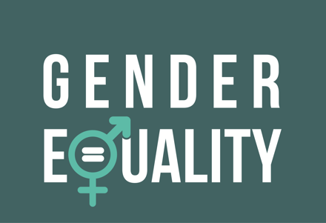
3.1.6 Good Action Plan examples
Some good examples from which you can take ideas to design your Action Plan:
WomenCanBuild
Project developed by the Fundación Laboral de la Construcción in Spain, in collaboration with the Agencia para el Empleo de Madrid in Spain, the Institute for VET in Construction Sector in Italy, the ECIPA Foundation in Italy, the CENFIC professional Training Centre of the Civil Construction Industry and Public Works in Portugal and the BZP training organisation in buildings from Germany.
The project aimed to improve equal opportunities for women in the construction sector. You can find the ACTION PLAN designed below. ²⁹
CLICK
TO VIEW
Teagasc Gender Equality Plan
TEAGASC is the Agriculture and Food Development Authority – is the national body providing integrated research, advisory and training services to the agriculture and food industry and rural communities.
In February 2022 they presented the gender equality plan to be developed. You can read the whole document here: ³⁰
HEA:Higher Education Authority
The HEA is leading Ireland's development strategies within the higher education and research system to achieve a number of objectives related to a coherent system of diverse institutions with different missions.
The HEA published in 2016 the first National Gender Equality Review of Irish Higher Education Institutions. Here you can find the second report published in November 2022. ³¹
CLICK
TO VIEW
CLICK
TO VIEW
²⁹ Women Can Build, Erasmus+ https://www.womencanbuild.eu/wp-content/uploads/2021/01/IO4_Action-Plan_WCB-160x200_EN.pdf
³⁰ Teagasc Gender Equality Plan https://www.teagasc.ie/media/website/publications/2022/Teagasc-Gender-Equality-Report-2021.pdf
³¹ Irish Higher Education Authority https://hea.ie/assets/uploads/2022/03/Report-of-the-Expert-Group-2nd-HEA-National-Review-of-Gender-Equality-in-Irish-Higher-Education-Institutions-1.pdf

Slide 54
3.2 Best practice.
Gender expert advice
Awareness-raising policies within organisations and companies, as well as the development and implementation of egalitarian measures are essential to improve the visibility and situation of women in the construction sector; a sector which, as we have already mentioned, is predominantly male.
Action Plans within organisations are a tool to start raising awareness and promoting the inclusion and equality of women in the sector, but there are other measures and advice to be considered.
3.2.1 Commitment to equality policies and regulation
Companies and organisations are increasingly committed to equality within the workplace, but there is still a need to encourage more commitment to development and inclusion work from a compliance, regulatory, legislative and equality perspective.
“There must be prior awareness so that the policies that may emerge are well received ”.
Alicia Sánchez. Employment and Gender Intervention Technician from Spain
It is important that all these rules are not only implemented but also accepted for their correct compliance, and implementation within organisations, not solely managers, but that the information is positively reinforced to all workers through trainings and orientations.

Slide 55
3.2.2 Visibility and female referents in the sector
Although the situation has been changing in recent years, in the EU we still find that the representation of women in the construction sector is 9%, not because there are no women in the sector, but because in many cases they are not made visible by the organisations themselves or female references in the sector are not promoted.
The lack of female role models is one of the biggest problems in the fight for equality in construction. Many of the stereotypes that exist about jobs within the sector are created by a lack of knowledge, as well as a lack of visibility of women who are already doing those jobs.
“A lot of people may be doing work, diversity, and inclusion work. But not talking about it, so we don't see it ”.
“Women are so underrepresented, especially in Ireland. For that, we need to be more open-minded in general about how women can do these jobs”.
Maria Hegarty, Equality Expert from Ireland
Lola Gonzalez Equality Expert from Ireland
This lack of visibility and commitment on the part of organisations perpetuates gender roles and stereotypes that the sector itself has been destroying thanks to the re-industrialisation of the sector that has allowed many jobs traditionally related to physical strength to be performed by anyone. It is through visibility and communication that these gender roles can be broken, and the underrepresentation of women can be ended.
“Women are still underrepresented in many areas of the industry, particularly in trade and craft roles, and there is a persistent gender pay gap that needs to be addressed ”.
Hanna Larsen. Gender and Diversity Expert from Denmark

Slide 56
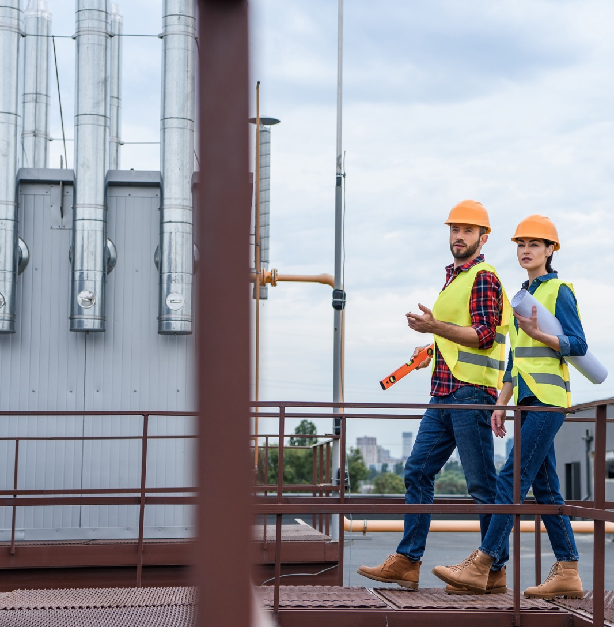
3.2.3 Training and career guidance
The lack of visibility and representation of female referents is associated with the training orientation towards young women who plan to develop their professional career in the construction sector.
“It would be also good to have specialized itineraries for women in the construction sector, to accompany these women ”.
Mónica Nevado. Consellor and Employment Technician from Spain
It is important that both trainers and companies seek to orientate women not only to sectors that have traditionally been feminised, such as the service or health sector. This orientation should be based on the visibility and representation of women in the sector to encourage young women to enter the construction sector and then continue to be accompanied by the commitment of business policies.
The industry itself is taking steps in this direction, trying to break down stereotypes that construction is a male sector, but again guidance and training still play a necessary role in offering more opportunities for women who want to work in construction.
“The industry has also been taking steps to promote gender equality, such as offering more education and training opportunities for women and creating a more inclusive work environment ”.
Sarah Hansen. Structural engineering from Denmark

Slide 57
“Every time when something is mono-dimensional when we only see one perspective, we are missing out.”
Sanja Ivandic Equality expert from Germany.
3.2.4 Generational change and innovation as tools for change
We are also at a time when the sector is undergoing a process of change and innovation. This means that more and more and better trained workers are needed to cope with the needs of the sector.
Women are a key player in facing the challenges of the construction sector and this is how organisations and employers must see it, challenging the gender roles mentioned above to have more opportunities for the future. It is women who play a key role here.
Moreover, as we have seen, the sector itself is facilitating the need to fill new jobs, both because of the large number of workers close to retirement age,
as well as expert workers in new jobs related to technological development, circular economy...
Social change happens slowly, but it does not happen by itself. In the construction sector, ideas have always been perpetuated that women cannot work in the sector, but we see these stereotypes changing in the new generations.
It is young women who know that they have labour rights that must be fulfilled, that their salary must be the same as men's and that they can do the same jobs as men.
“We see a generational difference in social attitudes. This is especially evident among young women. Women see that they have rights and are not afraid to reach for them either.”
Małgorzata Kopka- Piątek, Director of the European and Migration Policy Program at the Institute of Public Affairs, Poland

Slide 58
3.2.5 Action Plan FemCon

Slide 59
“A woman’s place is wherever she wants it to be, even in the cab in a 40-ton bulldozer”.

Slide 60
04
Inspiration towards the positive change in the construction industry

Slide 61
The construction sector has traditionally been masculinised, largely due to the relation of the sector's jobs to brute force, however the evolution of the sector has allowed many tasks to be mechanised, allowing both men and women to access and perform the same tasks.
Even so, the sector still presents difficulties for women both in accessing the sector and in maintaining and developing their professional careers in it. Some of these barriers are:
4.1 Good practices
The objective of including good practices is to help organisations and companies to have inspirational material to implement actions and measures that promote equality and gender equity policies.
The FEMCON Good practices programme responds to the need of organisations, VET educators, institutions... to have practical and accessible information for the implementation of gender strategies within the construction sector. In this way, we have included interviews, lessons learned or inspiring project initiatives to provide tools to educators and managers in the construction sector, with the intention to improve, make visible and increase the presence of women in construction.
TIPS - How can I do better?
The best way to improve is to start by becoming aware of the situation of women within our organisation or company. In this way, we can decide to commit ourselves to start taking actions that will bring about real change.
4.1.1 Commitment and action
As Małgorzata Kopka- Piątek, Director of the European and Migration Policy Program at the Institute of Public Affairs, Poland that should work to develop:
“Diversity of teams. Mechanisms by companies facilitate the reconciliation of roles. The importance of promoting examples of success among women and that construction jobs are not only for young female graduates.”
One of the actions to be taken by the leaders or managers of companies and organisations is a commitment to action. To this end, the agenda of actions and measures must be signed and implemented from the top, to ensure that they work for the promotion and representation of women within the sector.

Slide 62
4.1.2 Transparency and communication work
Communication, as many experts in the sector have told us, is essential for the promotion of women in the construction sector. On the one hand, communication campaigns must be carried out to make women already working in the sector visible, as well as innovation and current affairs in the construction sector, to show that it is a current sector, in the process of industrialisation.
As Sarah Jane Pisciotti, Innovation & Design Director at John Sisk & Son points out,
“It can be difficult for women to choose construction if they don't see positive representation in both companies and in the media. For this to become a reality it needs industry collaboration, government support and more media interest in real life stories to create the conditions that will attract a skilled workforce fit for our future needs”.
On the other hand, transparency is vital for the company or organisation to move forward. It is through transparency that the impact of the objectives is achieved.

Slide 63
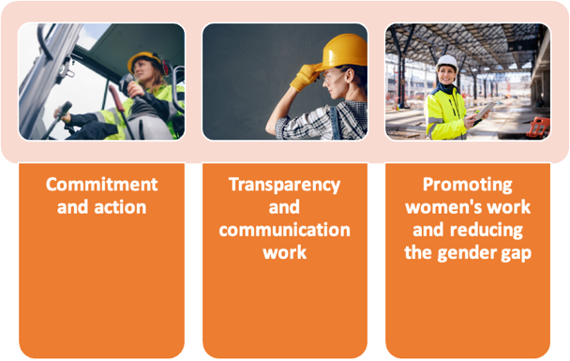
4.1.3 Promoting women’s work and reducing the gender gap
Policies must be adopted to promote equality within the sector and these measures must start with the selection processes, where there must be an egalitarian selection process, facilitating access to interviews from the first minute and not discarding profiles because they are women. Furthermore, it is at this point that a gender perspective should be included, using inclusive language.
If we already have women in the workforce, the visibility of women should be promoted, as well as their promotion through family reconciliation policies and measures, thus fighting against the image of "carer" that women often have, and which forces them to carry out functions more related to household chores and family care.
And finally, to try to combat the gender gap through actions or participation in projects and initiatives that promote the inclusion of women in the construction sector.
As Hanna Larsen. Equality expert:
“Achieving gender equality in the construction sector requires addressing systemic barriers such as gender stereotypes, lack of female role models and biases in recruitment and promotion processes”.
Figure 10: Own elaboration based on information supplied by the women interviewed.

Slide 64
QUIZ: Are You committed to equality in the construction sector?
Do you want to know if the company where you work is committed to the visibility and equality of women in your work? Do you think that your organisation is doing everything possible for equality between men and women in construction? We have developed a small questionnaire in which you can find out what level of commitment your company or organisation is at. You can access and answer the questions in the next link:
CLICK
TO VIEW

Slide 65
4.2 Aspects that inspire. What's next for young women?
Construction has much to offer young women considering a career in the sector. The construction industry is an ever-changing sector.
Europe's most influential women in the sector have offered their views, advice, and recommendations to both young women and women already working in the sector, to motivate them to continue to grow or to enter the industry.
We have compiled some of these highlights.
1
They are not alone.
Although the percentage of women in Europe working in the construction sector is 9%, there are more and more women in managerial positions, such as engineers or site managers... In addition, initiatives to increase women's presence and visibility have been growing in recent years.
The construction sector is still a very male-dominated sector, but this does not mean that women working in it should feel alone or isolated.

Slide 66
2
There is room and work for everyone.
The construction sector is one of the fastest growing sectors, even if it has suffered the consequences of the COVID-19 crisis or the war in Ukraine.
Even so, experts remind women who are thinking about a career in this sector that the construction sector is a sector in continuous expansion and that it will urgently need a workforce in the next 10 years. Therefore, there are and will be many jobs offers both in traditional trades and, above all, in professions related to digitalisation and new renewable energies.
Women must seize these opportunities and know how to make the most of them, as Natalija Plascevic, Director of Mechanical Installations Company in Germany, advises young women to turn the crisis and the lack of skilled labour to their advantage.
“Young women should study the demand, get trained and go for it”.

Slide 67
3
Don't set limits for yourselves.
The construction sector is a very masculinised sector and traditionally related to the work of force, but nowadays the sector is evolving as we have seen towards digitalisation or renewable energies.
Moreover, although the presence of women is still low, we can find women in different areas of the sector, from "field" work to management positions. These are the characteristics that women in the sector highlight to encourage young women to enter the construction sector. The sector itself does not place limits on women when it comes to working in it, it is the predetermined stereotypes, as well as the traditional image of the sector that place limits on ourselves. Limits that we should not set for ourselves.
“When you are passionate about playing a part in construction or in transforming the industry, it's very easy to find a home here. There’s a place for everyone working in the built environment ”.
Sarah Jane Pisciotti, Innovation & Design Director at John Sisk & Son

Slide 68
4
Knowledge is power
The lack of workers for the coming years goes hand in hand with the lack of trained and qualified employees. This is something that all the women have stressed to us. The importance of training for access and promotion in the construction sector.
The lack of workers is expected at all levels of education and training. That is why Kamila Slega Head of the Contract Engineer Team, P.U.I. EKO-INWEST from Poland, stresses and informs the young women that:
“The construction sector needs workers at all levels. Companies are looking for experienced employees”.
As an opportunity to access through their knowledge and training.
Moreover, construction is a sector where there is room for everyone with training and it is through these skills and knowledge that young women can enter the sector. Klara Lund Structural Design and Analysis expert advice to young women interested in construction:
“Do your research, acquire the relevant skills and be confident in yourself and your abilities”.

Slide 69
5
Rewarding and different sector.
Another characteristic to consider is the difference and the different options that exist in construction, where every day is different. It is a sector where, in the end, buildings, homes, residences, hospitals, educational centres... are constructed, giving meaning to the work carried out and being very rewarding at the end of the day.
Petra from Germany recommend the sector for young women:
“No working day is the same, everyday there are new challenges, but the feeling of satisfaction at the end of each project is priceless”.
Moreover, the sector is constantly changing and little by little the gender stereotypes and the idea that it is a sector only for men are being destroyed, as Deirdre Bennett CPO JJ Rhatigan & CO from Ireland points out, encouraging young women to banish these ideas and discover a different sector:
“Women should not limit themselves because they think they very cannot have those skills to work in the sector. Construction is no longer the traditional one we have in mind. A lot of possibilities are opening related to new energies ”.

Slide 70
Bibliography
Ben F. Bigelow, Anusree Saseendran & Jonathan W. Elliott (2018) Attracting Students to Construction Education Programs: An Exploration of Perceptions by Gender, International Journal of Construction Education and Research, 14:3, 179-197, DOI: 10.1080/15578771.2017.1280101r
Chadwicks Group (2023) https://chadwicksgroup.ie/lack-of-female-role-models-and-representation-is-the-key-barrier/
Chamber of Civil Engineers, Poland (2021) Available
at: https://www.piib.org.pl/
Committee for European Construction Equipment,
CECE (2023): Annual Economic Report. Accessed at:
https://www.cece.eu/news/cece-annual-economic
report-2023
Construction Industry Federation Ireland. (2018)
Women in the Construction Industry. Accuracy
Marketing. Costruzioni Italia S.P.A. (2022):
Superbonus 110%
https://www.costruzioniitalia.it/servizi/superbon
s10/#:~:text=''Casa%20a%20zero%20o%20zero,202
%20al%2031%20dicembre%202021 Accessed in May
2023
Euroconstruct (2022) - Euroconstruct report.
Available at: https://itec.es/servicios/estudios-mercado/euroconstruct-sumario-ultimo-informe/
Accessed in May 2023
European Centre for the Development of Vocational Training, Eurostat (2020)
https://www.cedefop.europa.eu/en/tools/skillsintelligence/self-employment?year=2020&country=EU#6
European Institute for Gender Equality (2019):
Gender planning. Luxembourg. Accessed at:
https://eige.europa.eu/sites/default/files/mh03192
3enn_002_0.pdf
European Commission (2022) Fostering the demand for a skilled labour force in the construction industry. https://build-up.ec.europa.eu/en/resources-and-tools/articles/overview-article-fostering-demand-skilled-labour-force-construction . Accessed in May 2023
European Commission (2001) Communication from the Commission to the Council and the European Parliament— Programme of action for the
mainstreaming of gender equality in Community development co-operation, (COM 295 final), Available at: http://www.europarl.europa.eu/sides/getDoc.do?pubRef=-//EP//TEXT+RE-PORT+A5-2002-0066+0+DOC+XML+V0//EN Accessed April 2023
European Commission. Women Can Build (2021) Erasmus+ Available at
https://www.womencanbuild.eu/wp-content/uploads/2021/01/IO4_Action-Plan_WCB-160x200_EN.pdf Accessed April 2023
European Institute for Gender Equality (2019): Gender planning. https://eige.europa.eu/gender-mainstreaming/tools-methods/gender
planning?language_content_entity=en#:~:text=The%20European%20Commission%20defines%20gender,or%20action'%20%5B1%5D. Accessed in April 2023.
European Construction Sector Observatory, 2021
Eurostat(2021)https://ec.europa.eu/eurostat/cache/digpub/housing/bloc-3a.html?lang=en#:~:text=Gross%20value%20added%20of%20the,the%20period%202010%20to%202021. Accessed May 2023
Eurostat (2023) Share of women by economic activity (from 2008 onwards, NACE Rev.2) – 100
Federal Employment Agency/ Bundesagentur für Arbeit. Date unknown. Available at https://www.arbeitsagentur.de/en
Fundación Laboral de la Construcción (2020): Count on them for your company. Action Plan for companies towards an equal opportunities sector. Madrid, Spain.
Accessed at: https://www.womencanbuild.eu/wp-content/uploads/2021/01/IO4_Action-Plan_WCB-160x200_EN.pdf
Gazeta Finansowa, Pearl of Polish Business Report, October 2021
German Federal Statistics Office/ Statistisches Bundesamt. Date unknown. Available at https://www.destatis.de/EN/Home/_node.html
Hatipkarasulu and Roff (2011): “Women in Construction: An early historical perspective”. The University of Texas at San Antonio. Accessed at http://ascpro0.ascweb.org/archives/2011/CEGT353002011.pdf

Slide 71
Higher Education Authority, Ireland (2022). Review of Gender Equality in the Irish Higher Education Institutions. Available at https://hea.ie/assets/uploads/2022/03/Report-of-the-Expert-Group-2nd-HEA-National-Review-of-Gender-Equality-in-Irish-Higher-Education-Institutions-1.pdf
Accessed in March 2023.
ILO, Strategy for Gender Mainstreaming in the Employment Sector: Summary matrix https://www.ilo.org/wcmsp5/groups/public/---ed_emp/documents/publication/wcms_190234.pdf
International Labour Organization ILO (2020): Empowering women at work – Company policies and practices for gender equality. Pag 64.
Available at: https://www.ilo.org/wcmsp5/groups/public/---ed_emp/---emp_ent/---multi/documents/publication/wcms_756721.pdf
International Labour Organization (2015) Women in business and management: gaining momentum. Available at: https://www.ilo.org/wcmsp5/groups/public/---dgreports/---dcomm/---publ/documents/publication/wcms_316450.pdf
Plan Radar (2022) Available at https://www.planradar.com/de/frauen-am-bau/
Spanish Construction Industry Observatory (2023): Women in Construction 2022
https://www.observatoriodelaconstruccion.com/informes/detalle/mujeres-en-el-sector-de-la-construccion2022#:~:text=En%20la%20edici%C3%B3n%202022%20del,este%20y%20otros%20datos%20de Accessed in May 2023
Statistics Denmark (2020) Employment by industry, occupation, sex, and region Report 2020
Structural Transformation to Achieve Gender Equality in Science, STAGES (2013). Available at http://stages.csmcd.ro/index.php Accessed in April 2023
Teagasc (2021) Gender Equality Plan. Available at https://www.teagasc.ie/media/website/publications/2022/Teagasc-Gender-Equality-Report-2021.pdf
Accessed in March 2023
The Smith Institute (2014): Building the future: women in construction. Available at: https://www.women-into-construction.org/wp-content/uploads/2019/08/building-the-future-women-in-construction.pdf
Why Diversity Matters. (2015) McKinsey & Company
Winke, Rebecca (2023): History of women in construction. Family handyman. https://www.familyhandyman.com/article/women-in-construction-history/
Woodward, D. 1995 Men at Work: Labourers and Building Craftsmen in the Towns of Northern England 1450–1750, Cambridge: Cambridge University Press.

Slide 72
table of
figures
01
Figure 1
Investment in housing in Germany, Denmark, Spain, Poland, and Ireland. Source: Eurostat
16
02
Figure 2
Share of women by economic activity. Source: Eurostat.
18
03
Figure 3
Concha Santos, President ANCI, Spain
28
04
Figure 4
Carol Tallon, Property District, Ireland
29
05
Figure 5
Ger Ronayne, CEO, JJ Rhatigan & Co
31
06
Figure 6
Concha Santos, President of Spanish National Association of Construction workers, Spain.
31
07
Figure 7
Jennifer Bradfield, Sisk, Ireland
34
08
Figure 8
Carolina Roca, Asprima, Spain
34
09
Figure 9
Shauna Coyne, COO,Skyclad Ltd, Ireland
35
10
Figure 10
Shauna Coyne, COO,Skyclad Ltd, Ireland
63

Slide 73
Appendices
A1 Research Information Sheet
A2 Research participant declaration
A1 Research Information Sheet
Thank you for considering participating in this research project. The purpose of this document is to explain to you what the work is about and what your participation would involve, to enable you to make an informed choice.
Femcon Project
The future of the construction industry in the EU is threatened by a chronic labour shortage exacerbated by the COVID crisis. The shortage of construction workers in the EU is expected to increase in the future due to a declining population and an ageing workforce. Across Europe, women make up only 9% of the construction workforce, leaving a huge talent pool that is not being used. The number of women in construction has fallen even further during the pandemic years. The EU construction industry needs to employ more women if it is to have a sustainable future. According to EUROSTAT, the construction sector has the highest percentage of male employees (92%).
Project objectives
FEMCON will develop innovative vocational education & training that will assist women working in or considering a career in construction industry to progress to visible roles within the industry. In so doing, FEMCON will increase the attractiveness of the industry for others, thus leading to a greater number of women choosing the sector. Our VET aimed education will further impact female workforce in the construction industry across Europe, to become aware of their rights to equality in the industry &to utilize their skills in the industry towards their careers progression, thus creating conditions for positive change to happen, improving the industry outlooks & these groups’ quality of life.
Research Objectives
Research The purpose of this study is to ascertain the main barriers to the recruitment of women in construction and what are the main drivers of change.
The purpose of this research is to gather expert knowledge from gender equality professionals on how to create an action plan to support women’s entry, retention, and attraction in the Construction industry.
Participation
Should you choose to participate, you will be asked to participate in an interview (online/face to face/email questionnaire with open ended questions) with a member of the research team. This interview will be audio-recorded and is expected to take 30-40 minutes to complete. Participation in this study is completely voluntary. There is no obligation to participate, and should you choose to do so you can refuse to answer specific questions or decide to withdraw from the interview. Once the interview has been concluded, you can choose to withdraw your details at any time in the subsequent six-month period.
Data protection
The data will be safely stored for______ Where? How Encrypted? The information you provide will contribute to the knowledge base on best practice for Women in Construction. All data will be managed in compliance with The General Data Protection Regulation (GDPR)
If you have a concern about how we have handled your personal data, you are entitled to this with the Data Protection Commission https://www.dataprotection.ie/
The Data Controller for this study is INCLUDE PRINCIPAL INVESTIGATOR’S NAME AND CONTACT DETAILS.
Queries
We do not anticipate any negative outcomes from participating in this study. Should you have any concerns arising from participating in the research, or should it raise any issues for you, the contact details for support services provided may be of assistance.
If you have any queries about this research, you can contact me at Please provide your contact details.
If you agree to take part in this study, please sign the consent form overleaf.

Slide 74
A2 Research participant declaration
I have read this information sheet and have had time to consider whether to take part in this study. I understand that my participation is voluntary (it is my choice) and that I am free to withdraw from the research at any time without disadvantage. Therefore, I agree to take part in this research.
(Please tick the box) Signature: __________________________________
I hereby give permission for the use of the data collected from me using the following methods only:
(Please tick the relevant box or boxes you are agreeing to)
All data collected from me: Signature: ________________________________
De-identified data only: Signature:___________________________________
Personal Details only: Signature:_____________________________________
Taped Interview (audio): Signature:__________________________________
Photographs: Signature:____________________________________________
Film/Video/DVD Signature:__________________________________________
I hereby give permission for the use of the data collected from me to be anonymised and archived for future use by other researchers:
All data collected from me: Signature: ____________________________________
De-identified data only: Signature: ____________________________________
Personal Details only: Signature: ____________________________________
Name of Participant (in block letters): ______________________________________
Signature: _____________________________
Date: / /

Slide 75
FOLLOW OUR JOURNEY
CLICK
TO VIEW

